Slide 1

Application & Instrument Training
TRIBOMETER
@ ITESM - CEM
Laboratorio de Tribología
Nora, thanks for your support

Slide 2

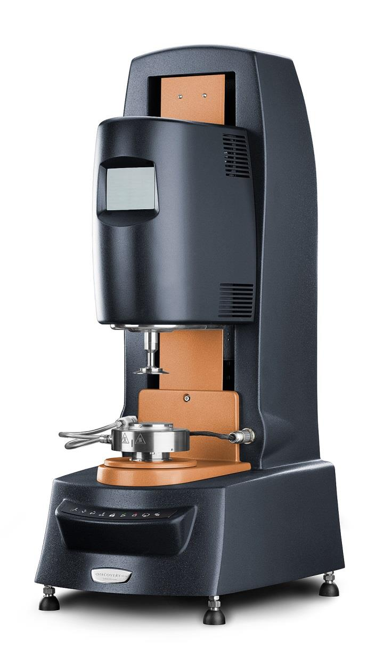
Introduction
Discovery Hybrid Rheometer (DHR) from TA Instruments.
Optical Encoder Dual Reader.
Resolution better than 2 nanoradians.
Advanced drag cup motor.
Keeps inertia, temperature and friction an absolute minimum.
2nd generation magnetic bearing.
Less than 70% of the friction of air-bearing.
It can measure down to 0.5 nNm of torque.
Force rebalance transducer (FRT).
High accuracy normal fo4rce measurements up to 50N.
True Position Sensor (TPS).
True gap accuracy via a high resolution linear position sensor.
Notes:
Discovery Hybrid Rheometer. (2019). TA Instruments. Online. [Available from] https://www.tainstruments.com/dhr-3/#ffs-tabbed-11

Slide 3

Purposes
To learn how to turn on the instrument in the correct order and the conditions needed for using it.
To understand the software and how to design Rheology experiments.
To learn how to calibrate the instrument before each experiment.
To perform rheology experiments for practicing.

Slide 4
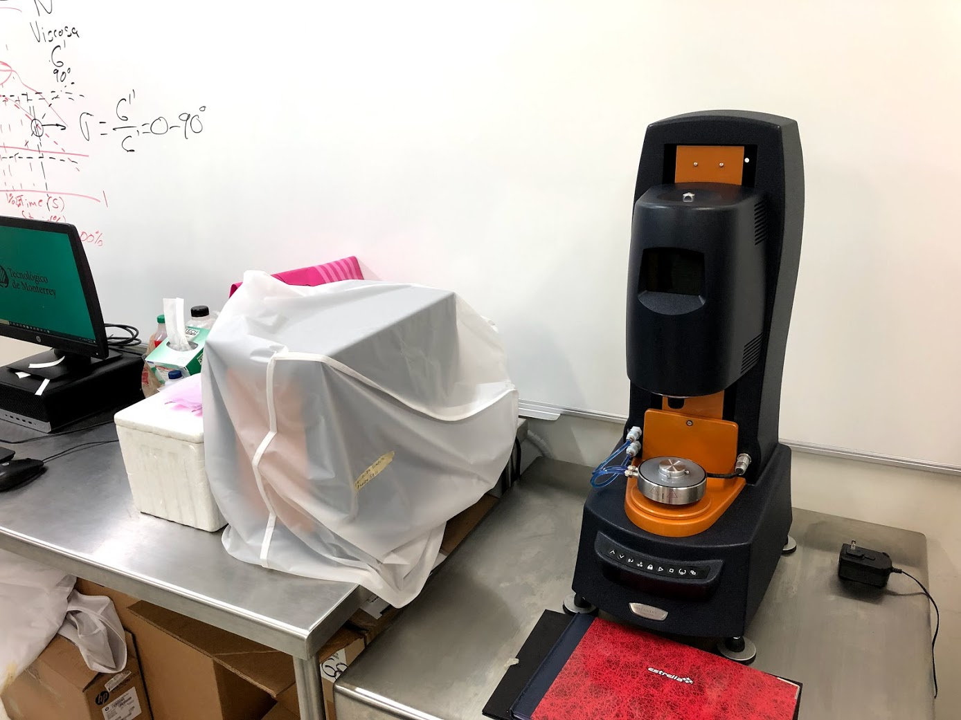
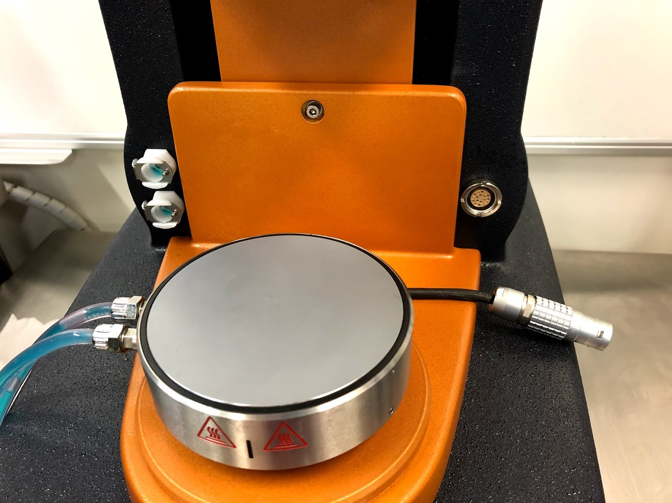
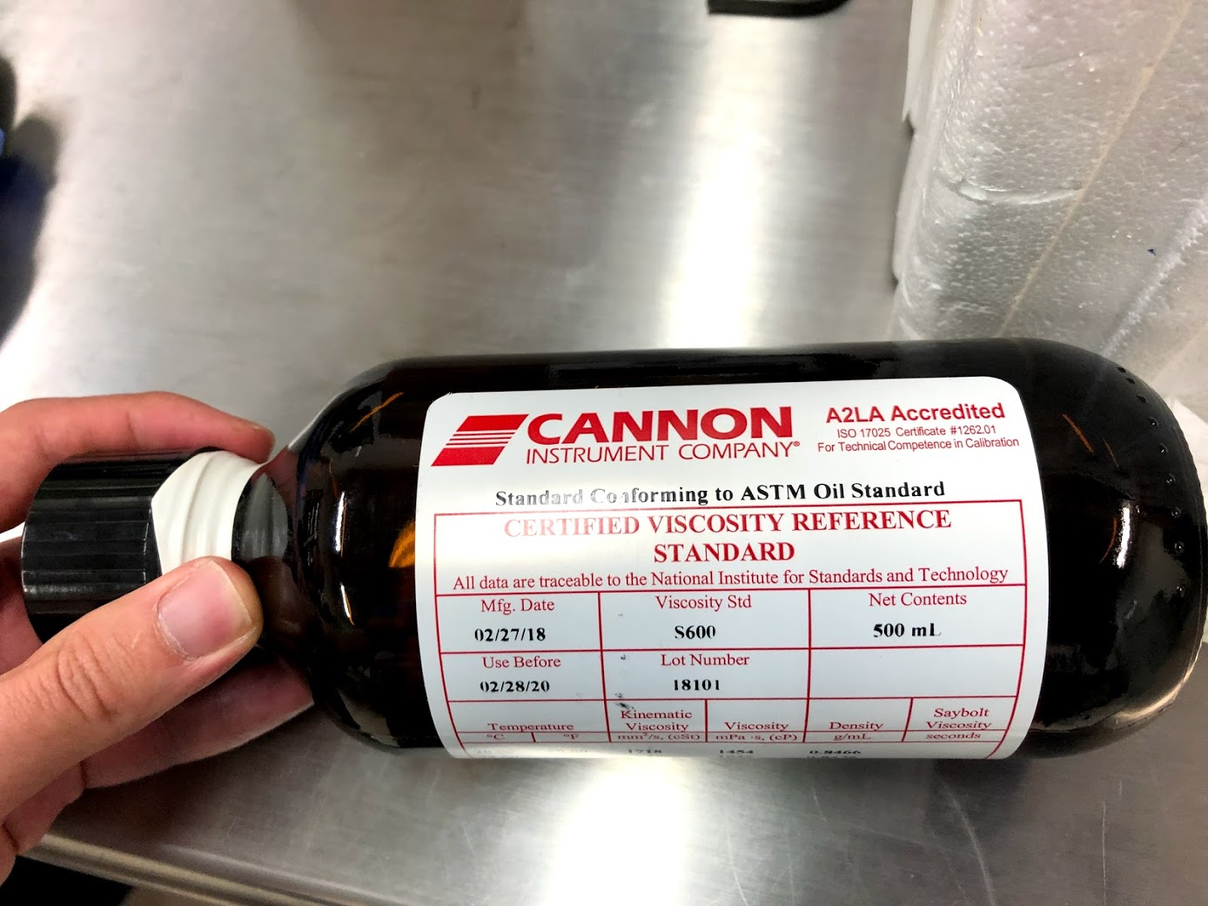
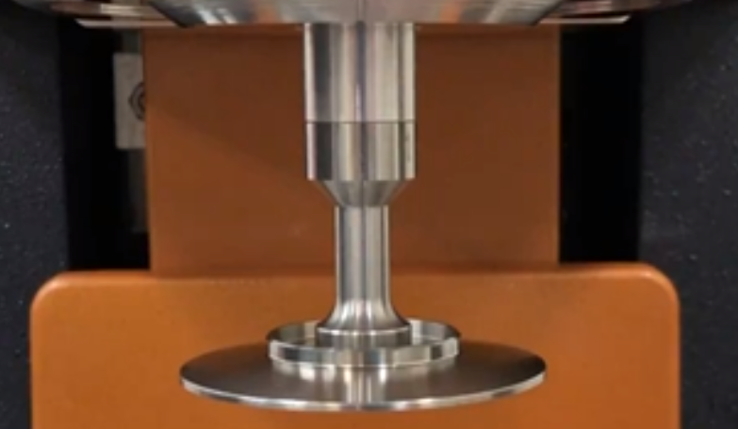
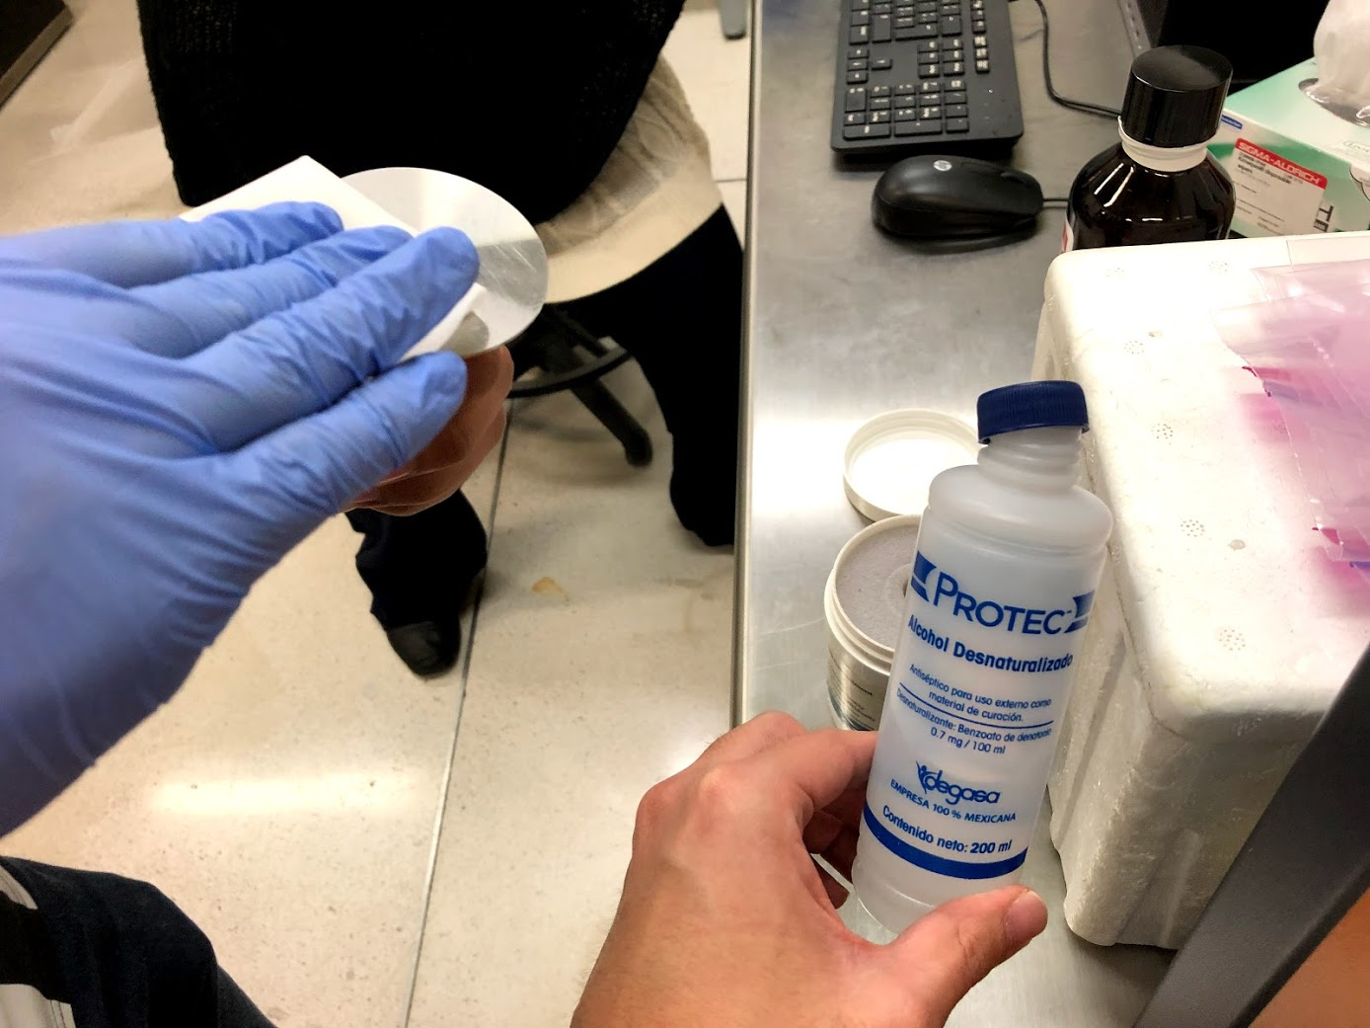
Materials
Peltier plate for rheology.
Certified Viscosity Standard. S600.
Geometry: Parallel plate 60 mm.
Ethanol.

Slide 5
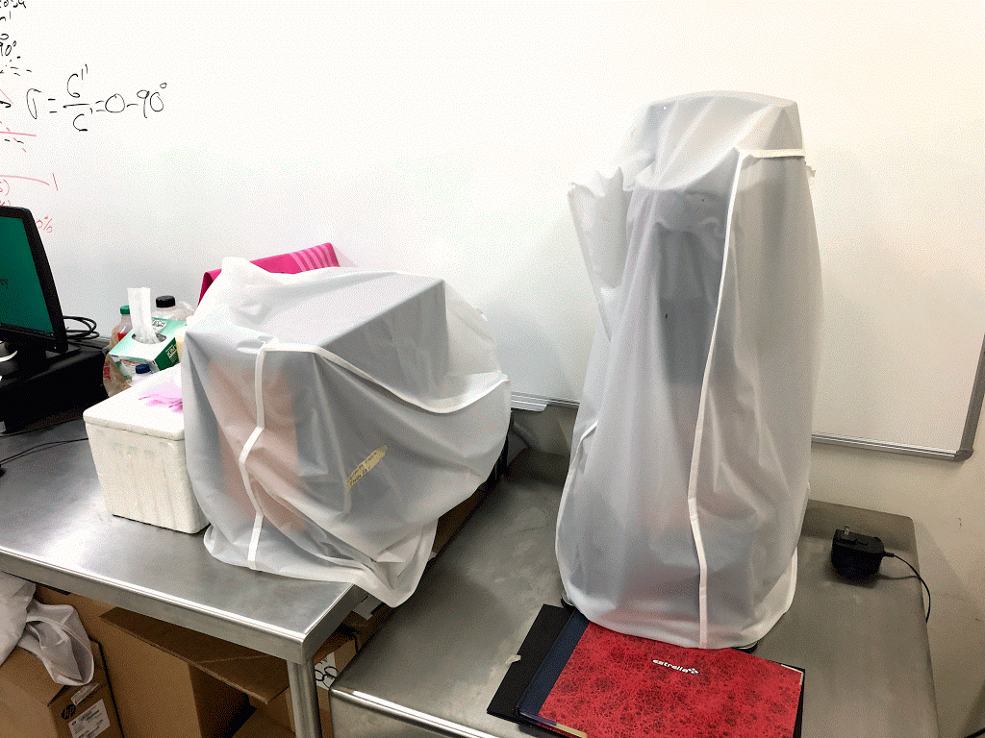
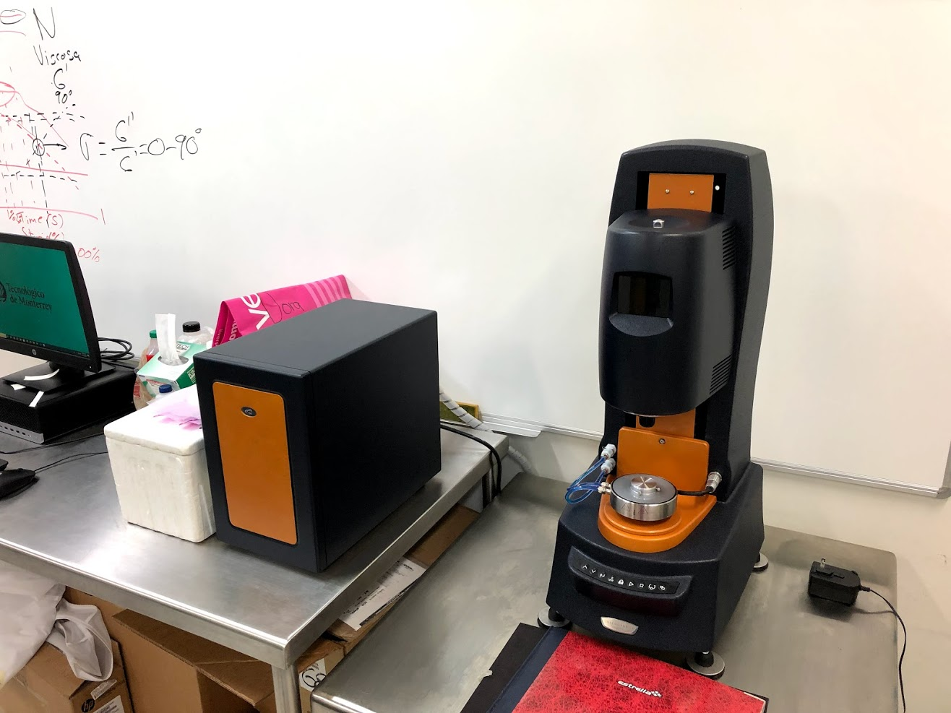
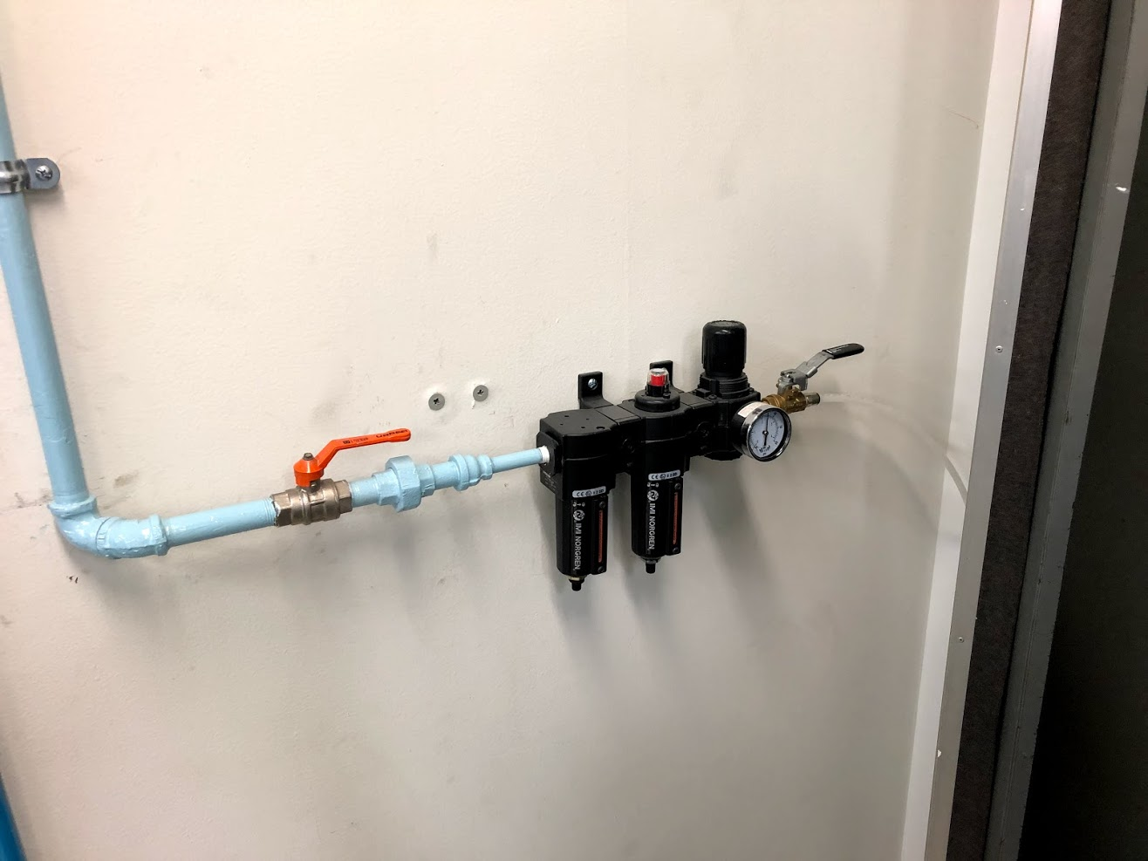
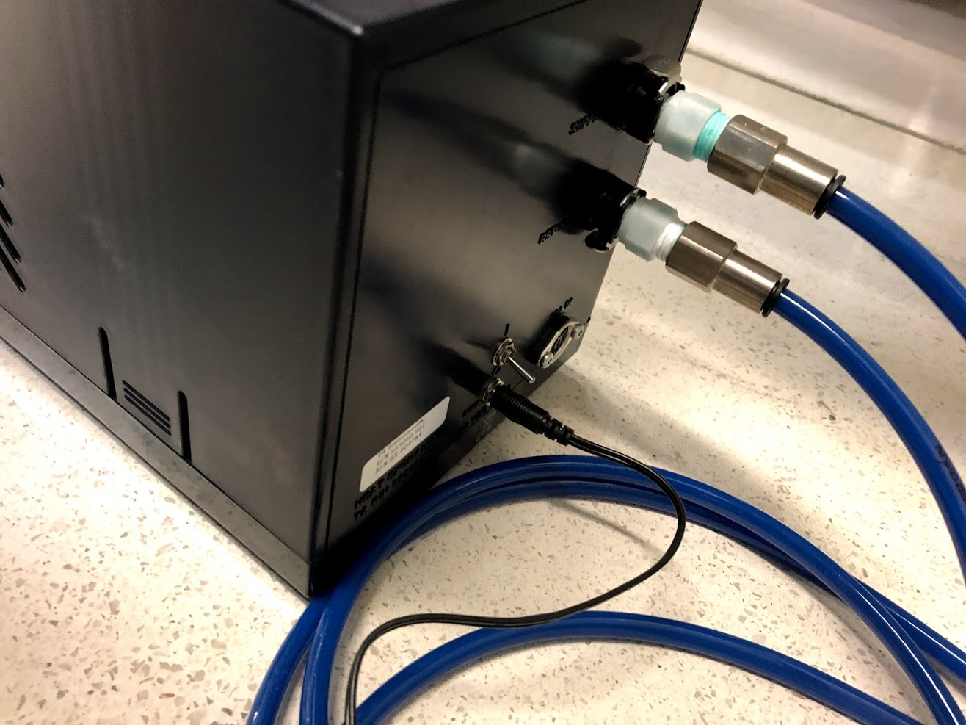
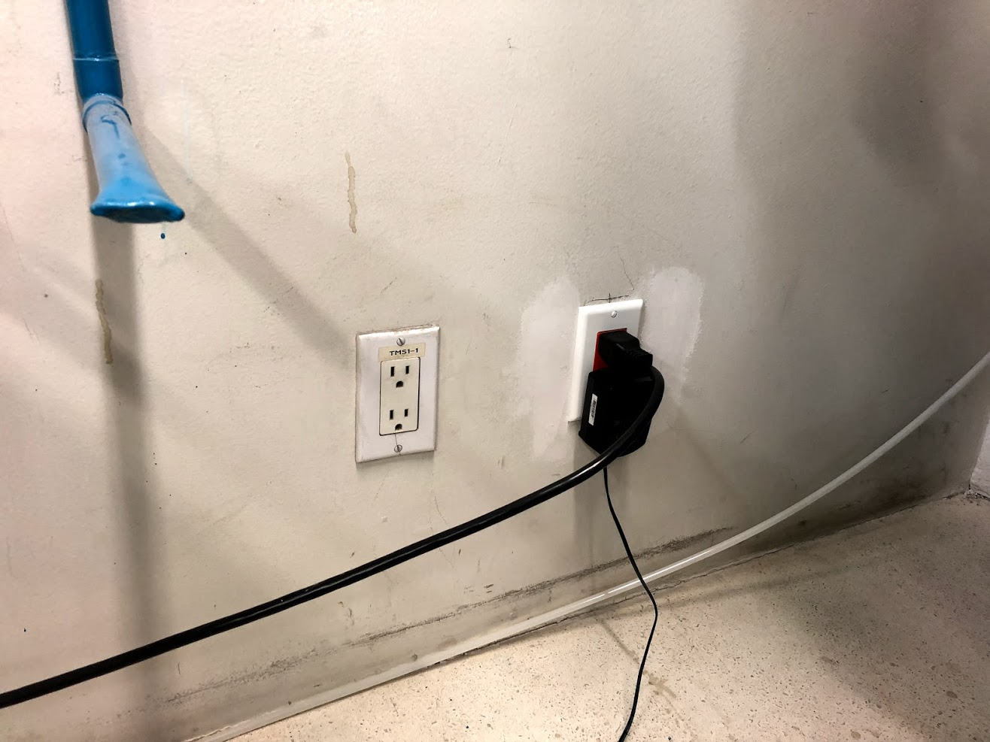
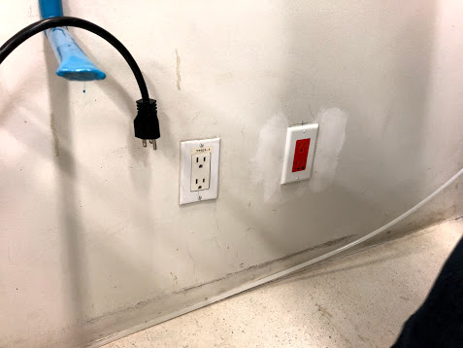
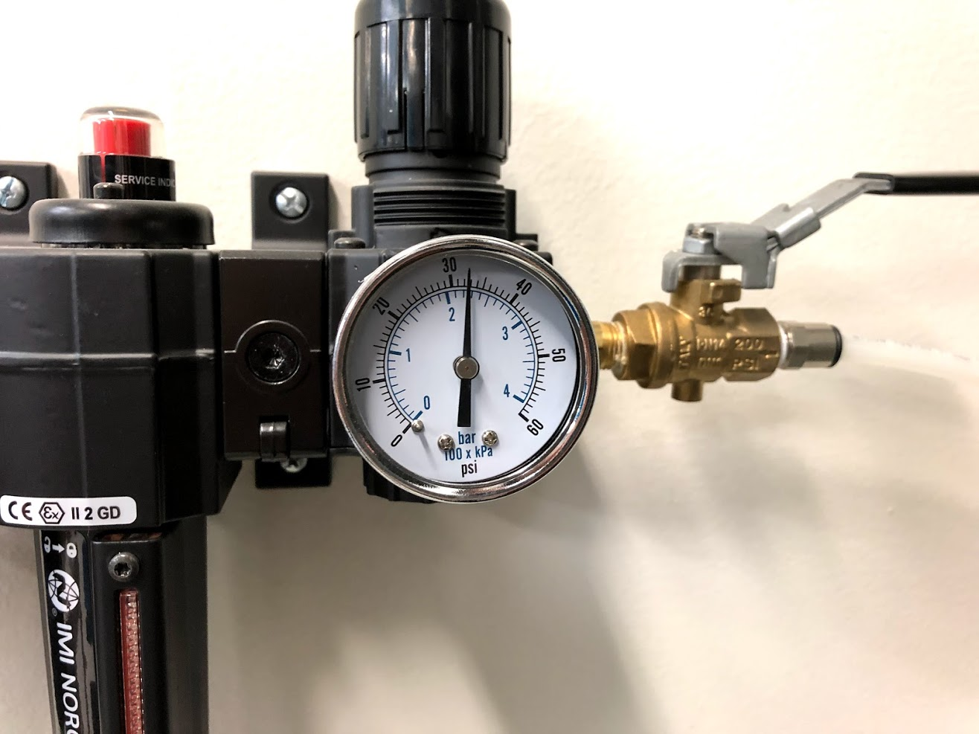
Procedure
Initial setup
remove protective covers
open air valves
AKA. ball valve / T
1era
2nda
check air pressure, which
shall be around 30 (±2) psi
SW UP is ON
---
DOWN
is OFF
turn on the TA-supplied Air Cooled Circulator (below the working table)
plug the instruments to the orange (isolated ground) outlet

Slide 6
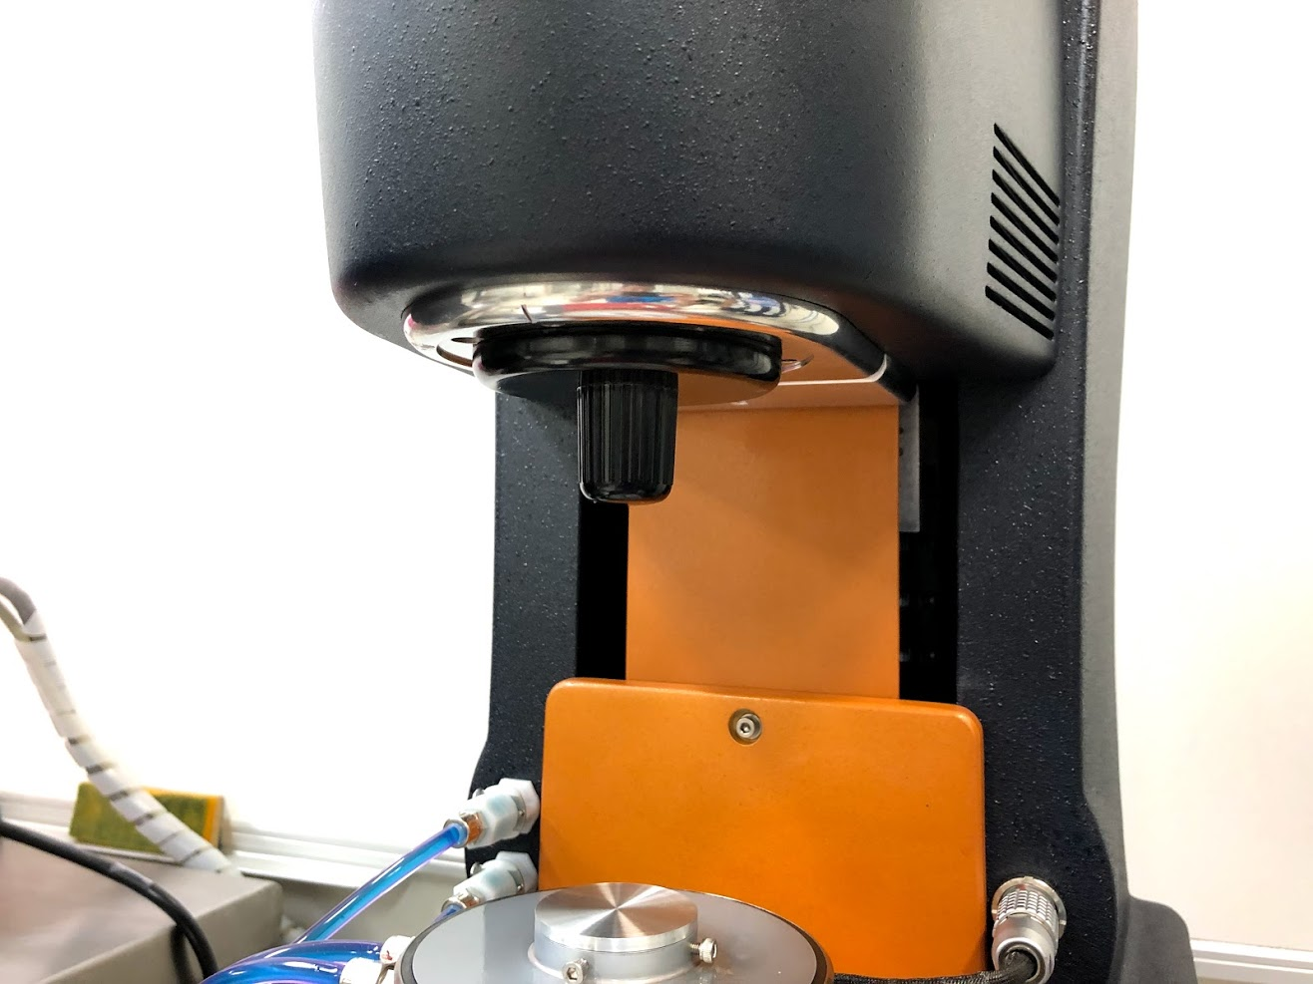
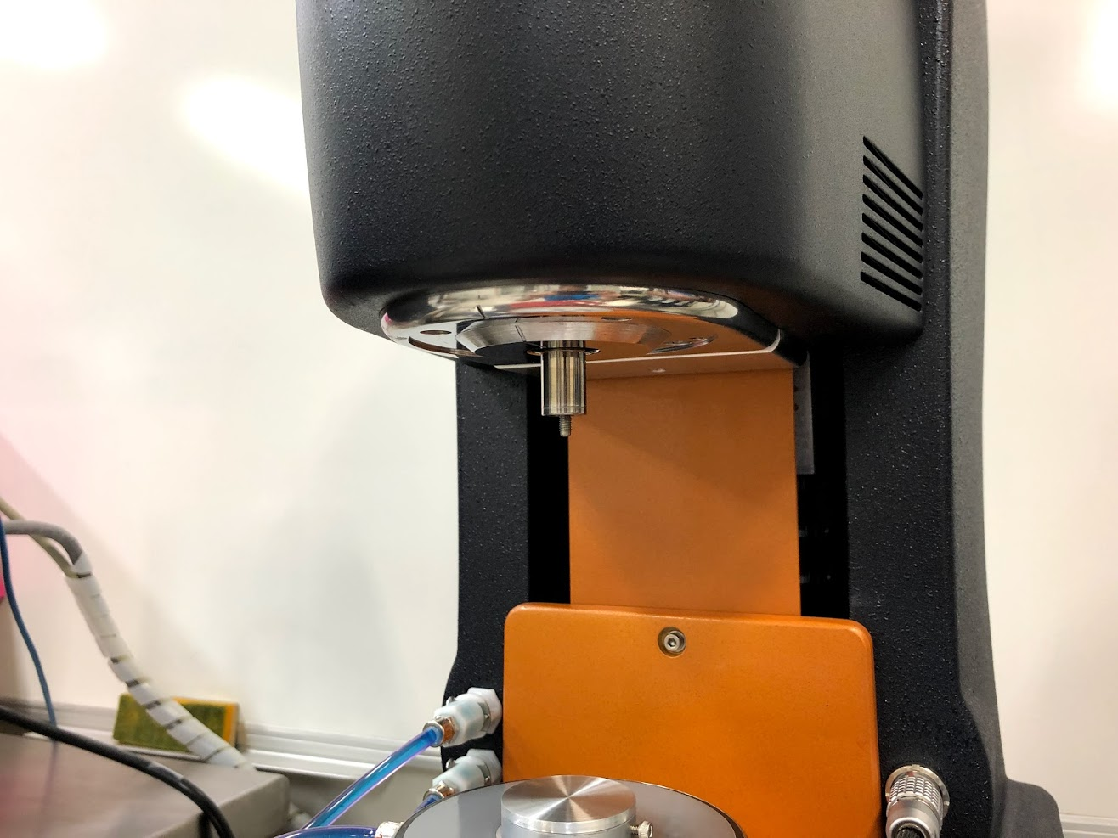
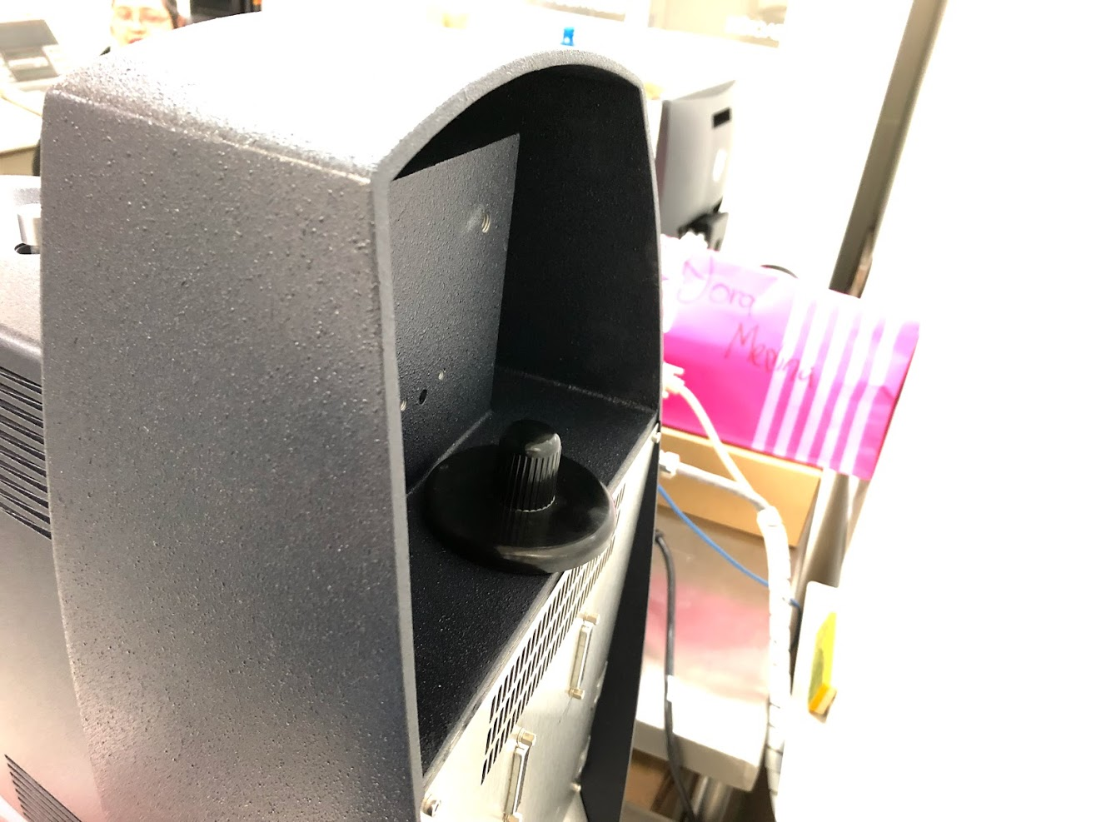
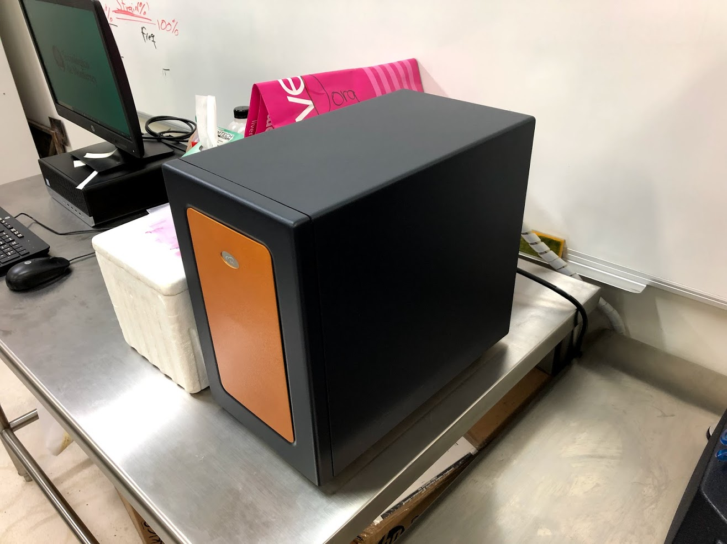
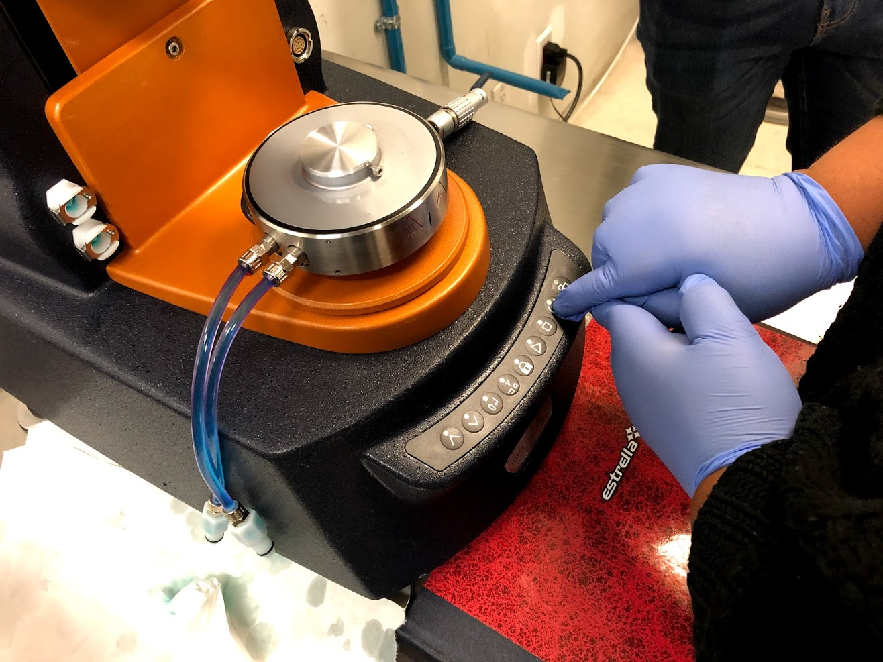
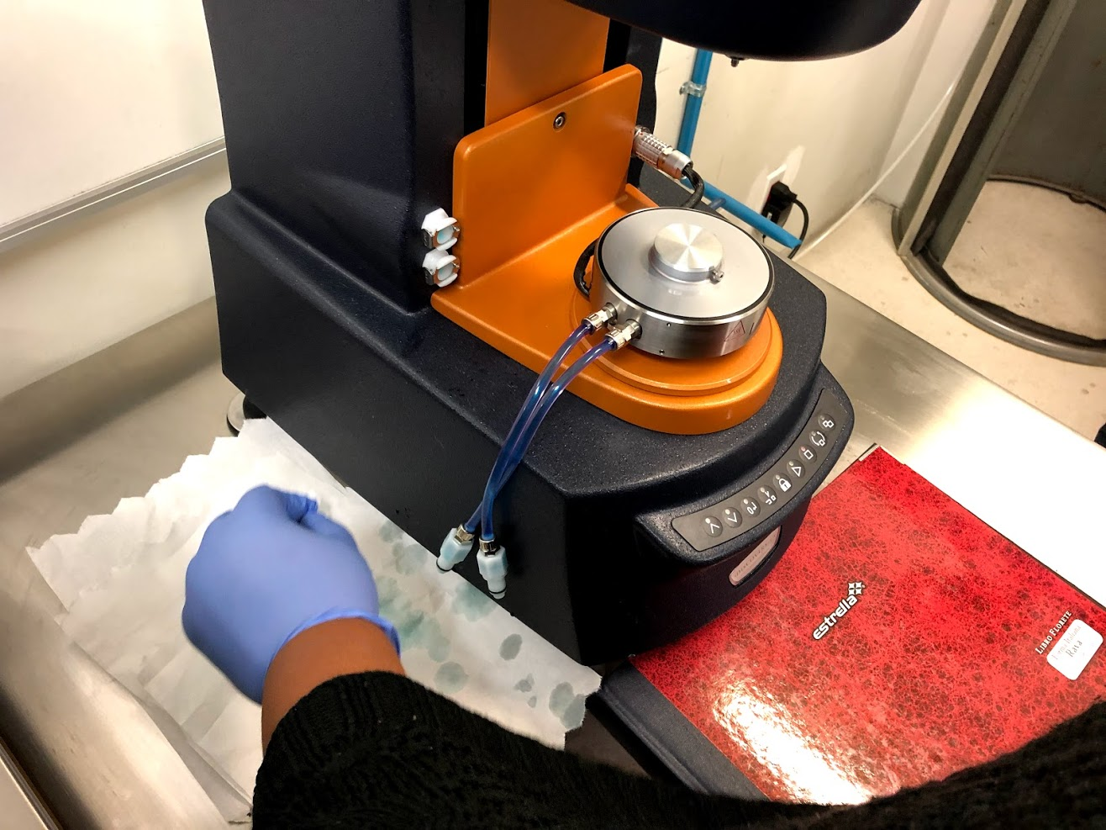
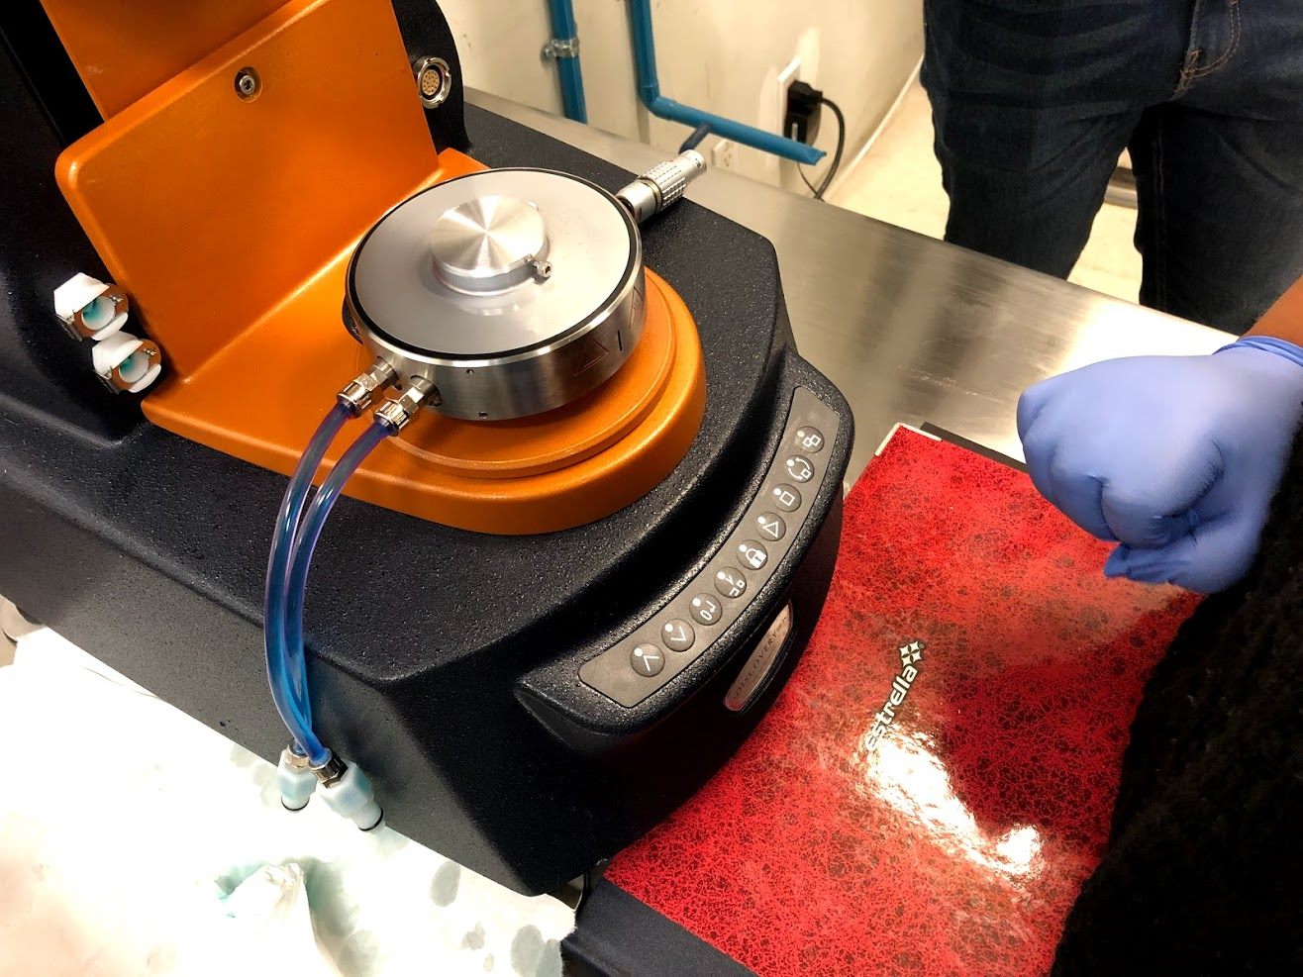
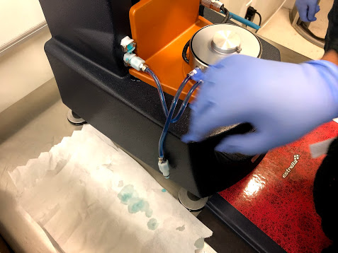

Procedure
Initial setup (continued)
remove the bearing clamp
turn on the Electronics Control Module
“I” is ON
---
“O”
is OFF
Replace the Lower Stage (if required)
Press the Release button
disconnect the power cable
disconnect the
fluid hoses

Slide 7
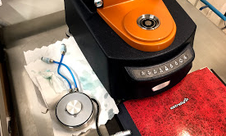
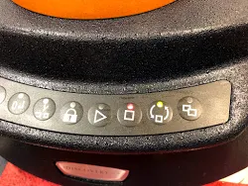
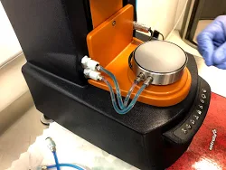
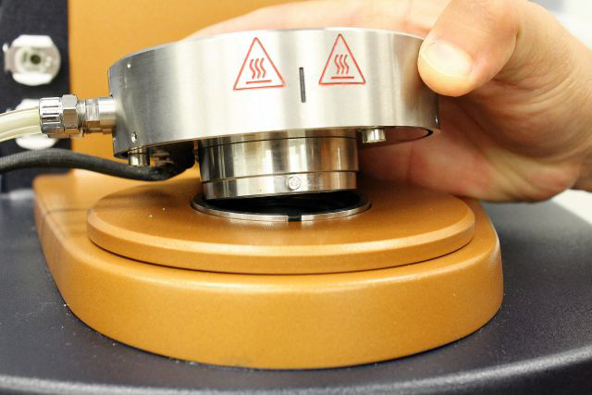
Procedure
Replace the Lower Stage (continued)
Press the Release button
again
remove the attachment
Press the Release button
again
align and fit
the attachment
connect the
power cable & fluid hoses

Slide 8
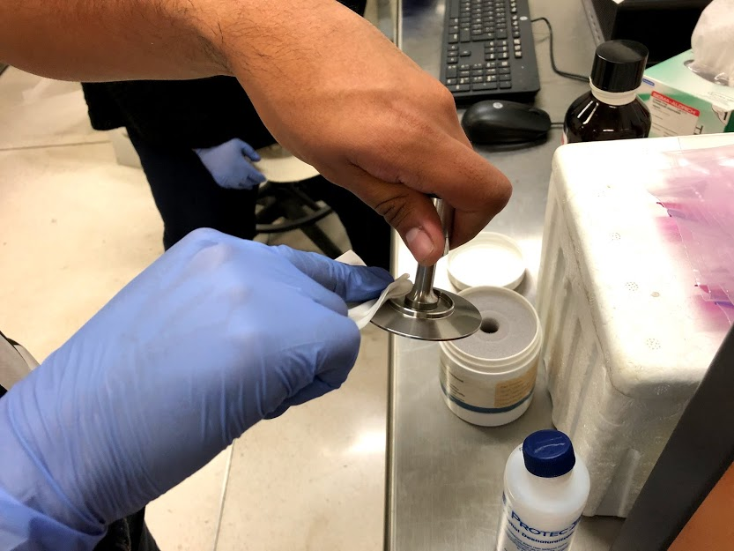
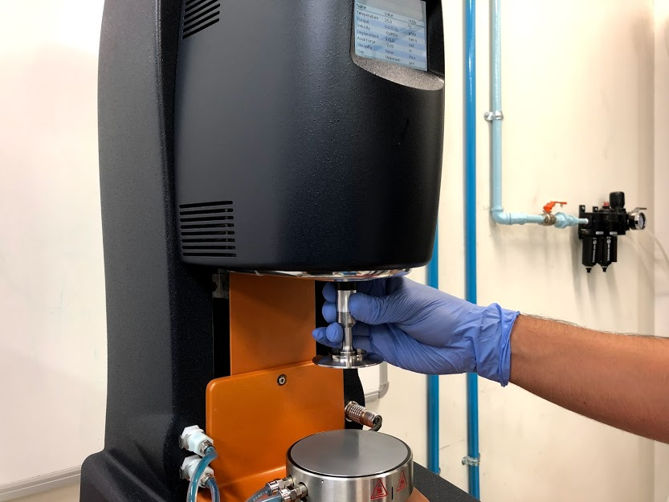
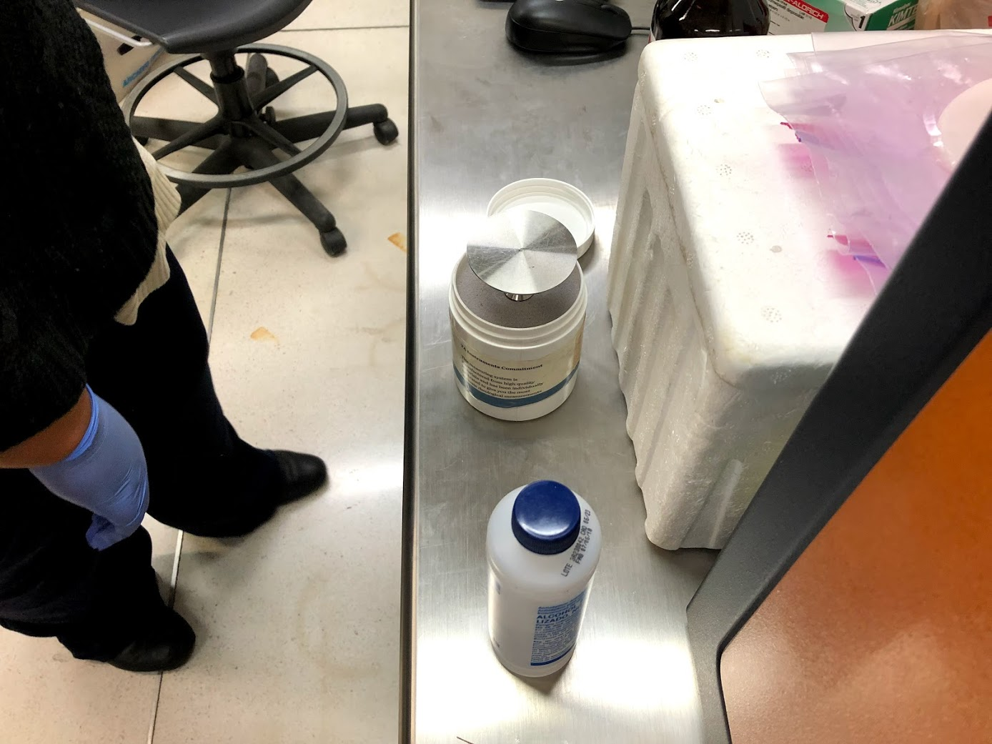
Procedure
Install a Geometry
clean the geometry
(with alcohol)
The geometry is gently placed
(clockwise direction until the first stop)

Slide 9
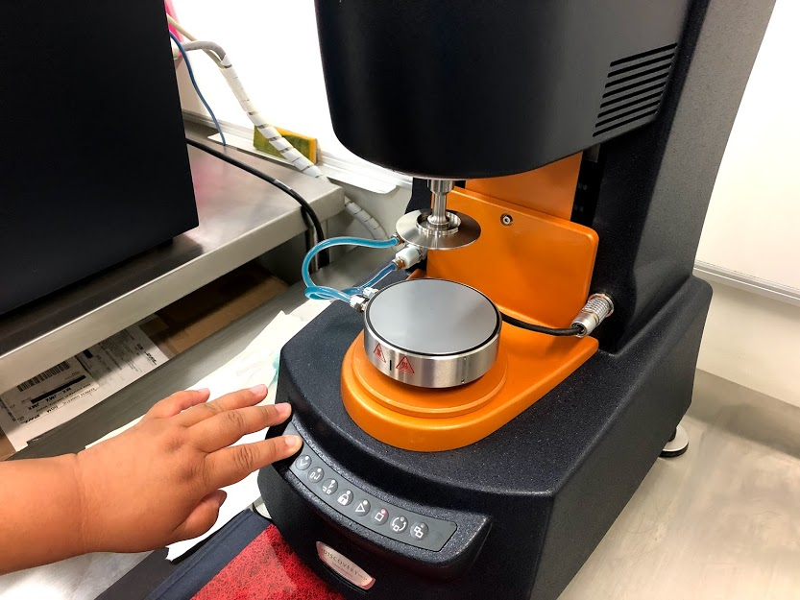
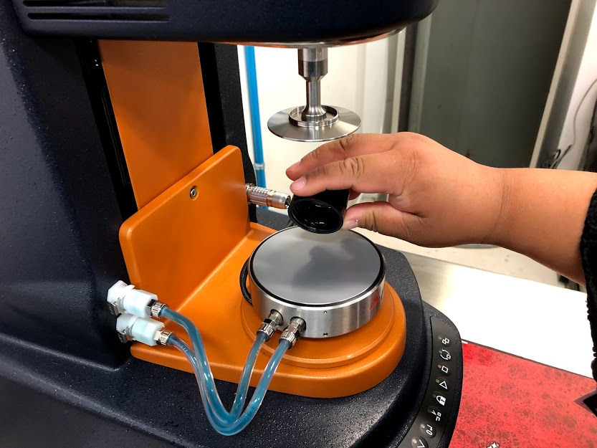
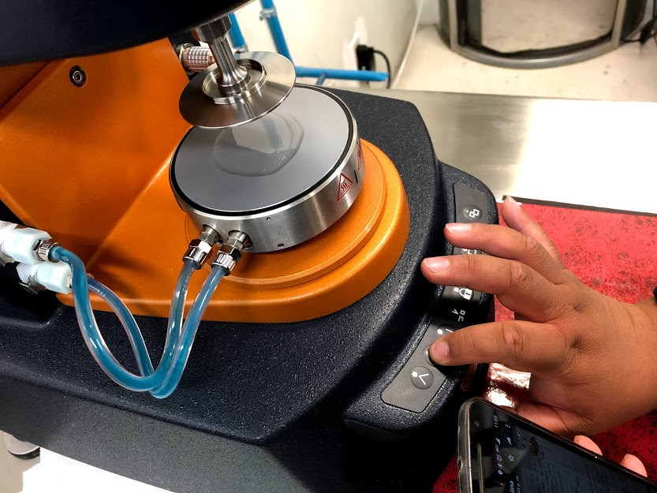
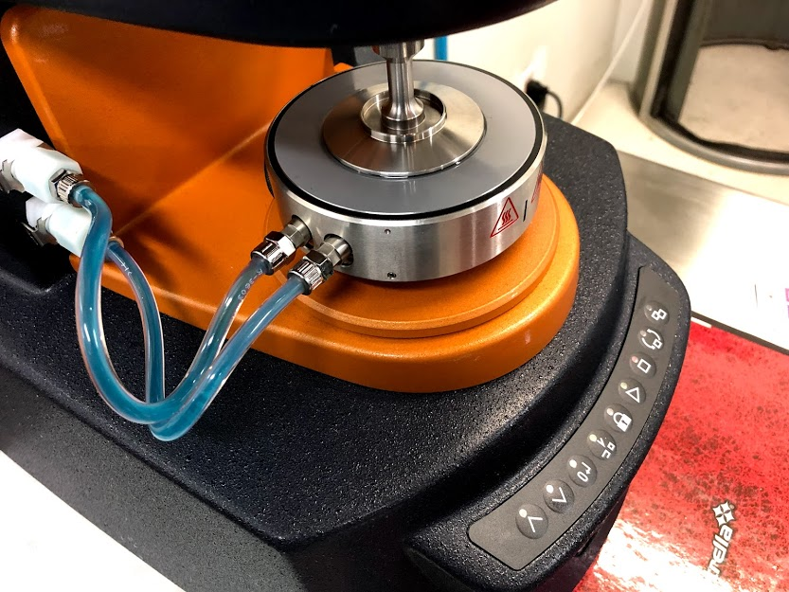
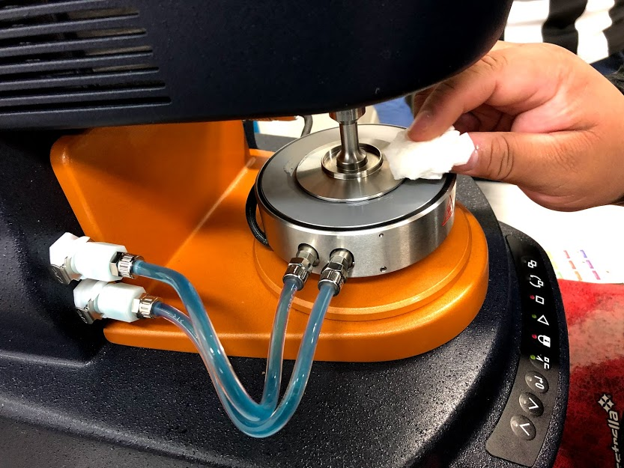
Procedure
Prepare the sample
the sample is placed on the Peltier plate
the geometry is lowered using the arrows
(until it is touching the sample)
the sample that comes out of the geometry, it is cleaned
It is checked that all the area of the geometry is covered by the sample

Slide 10
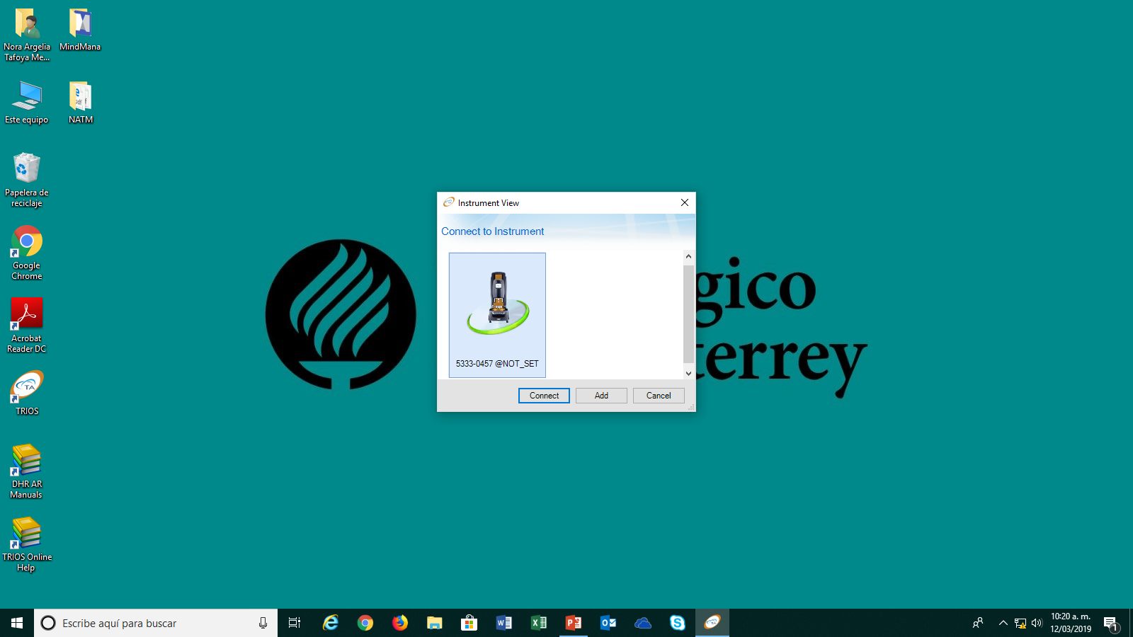
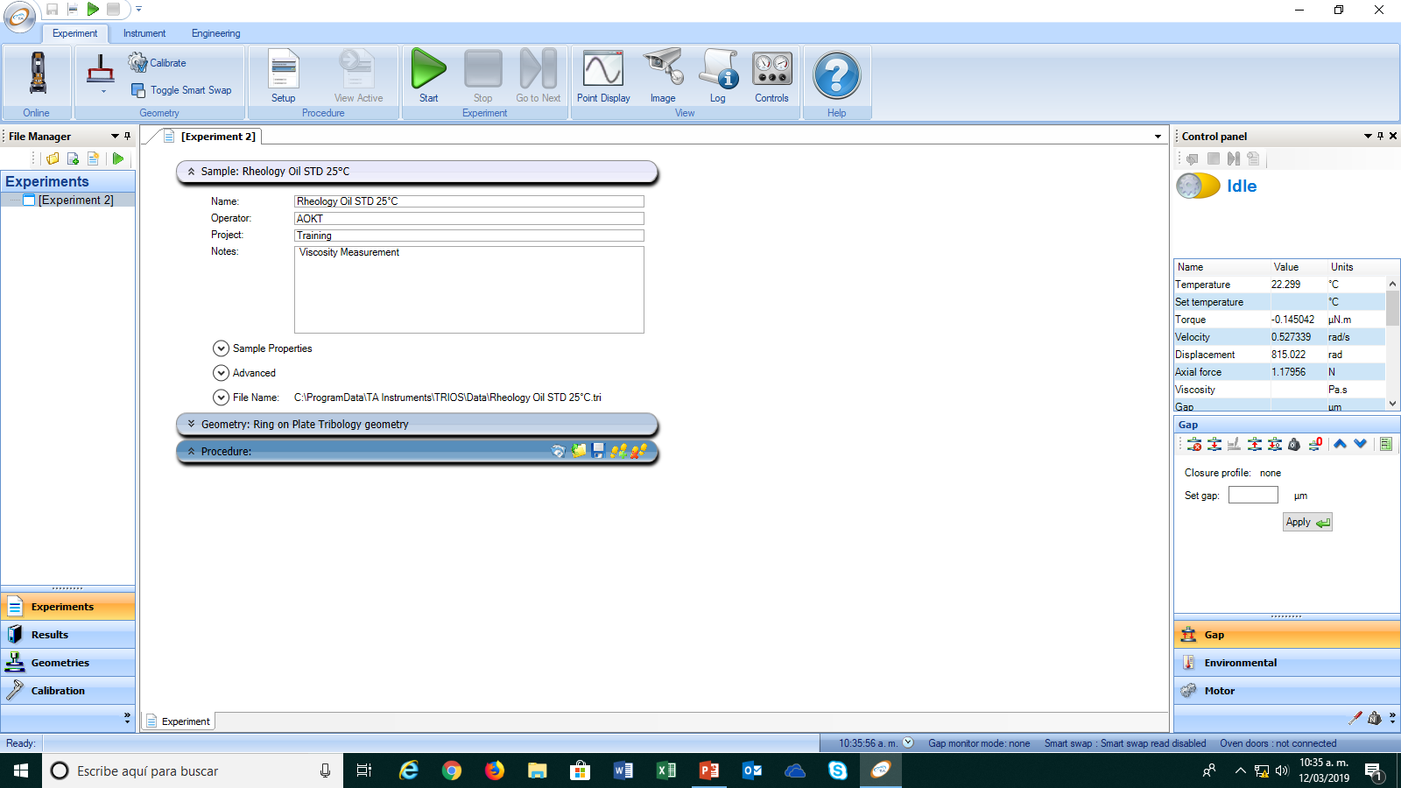
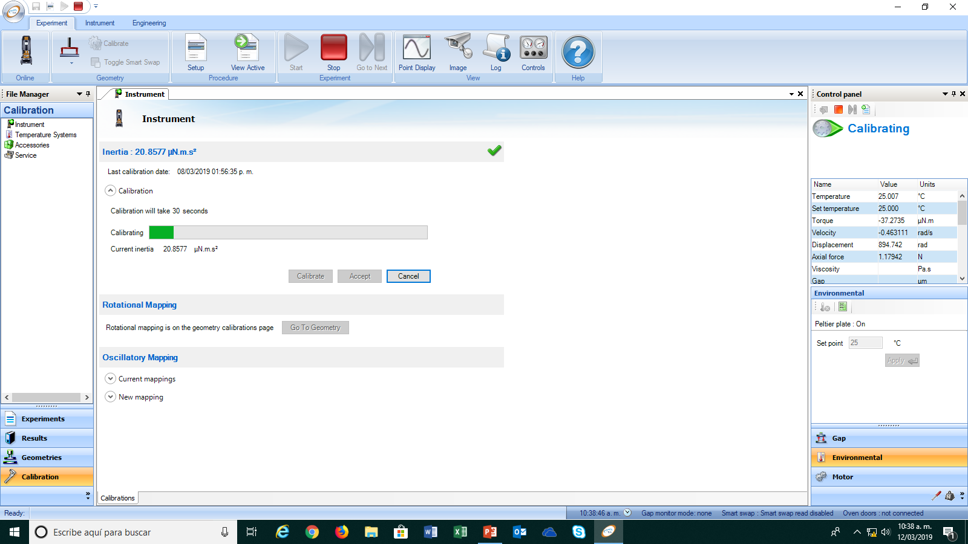
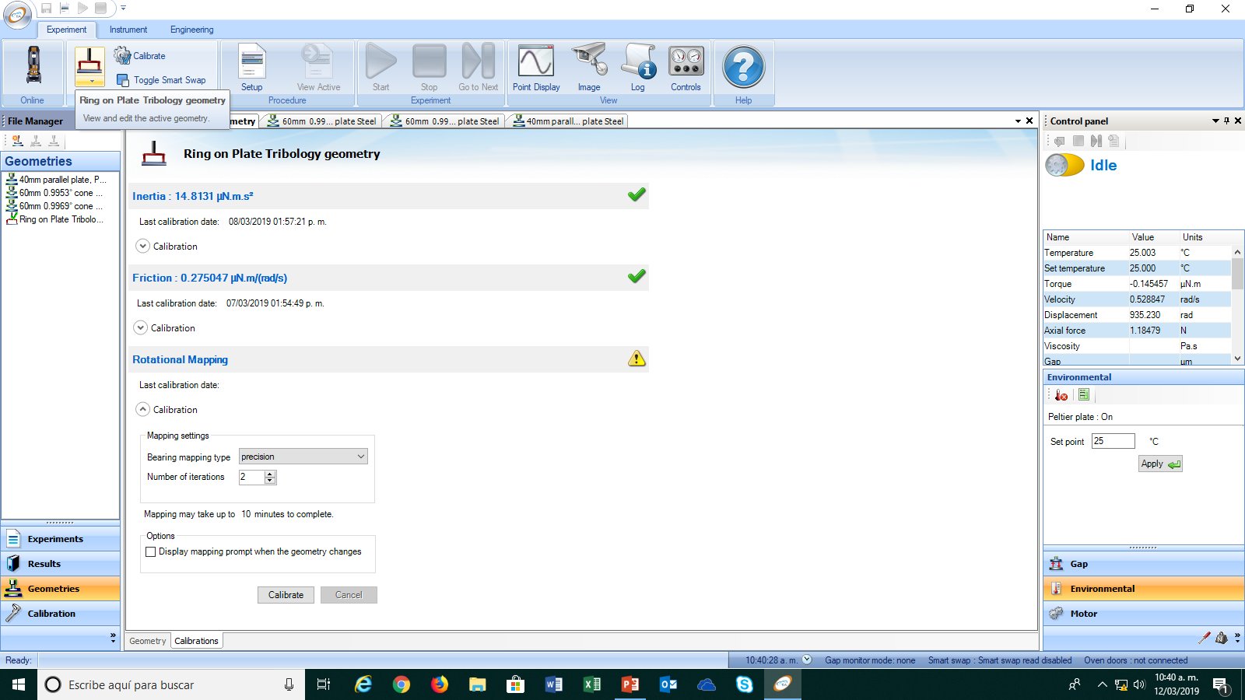
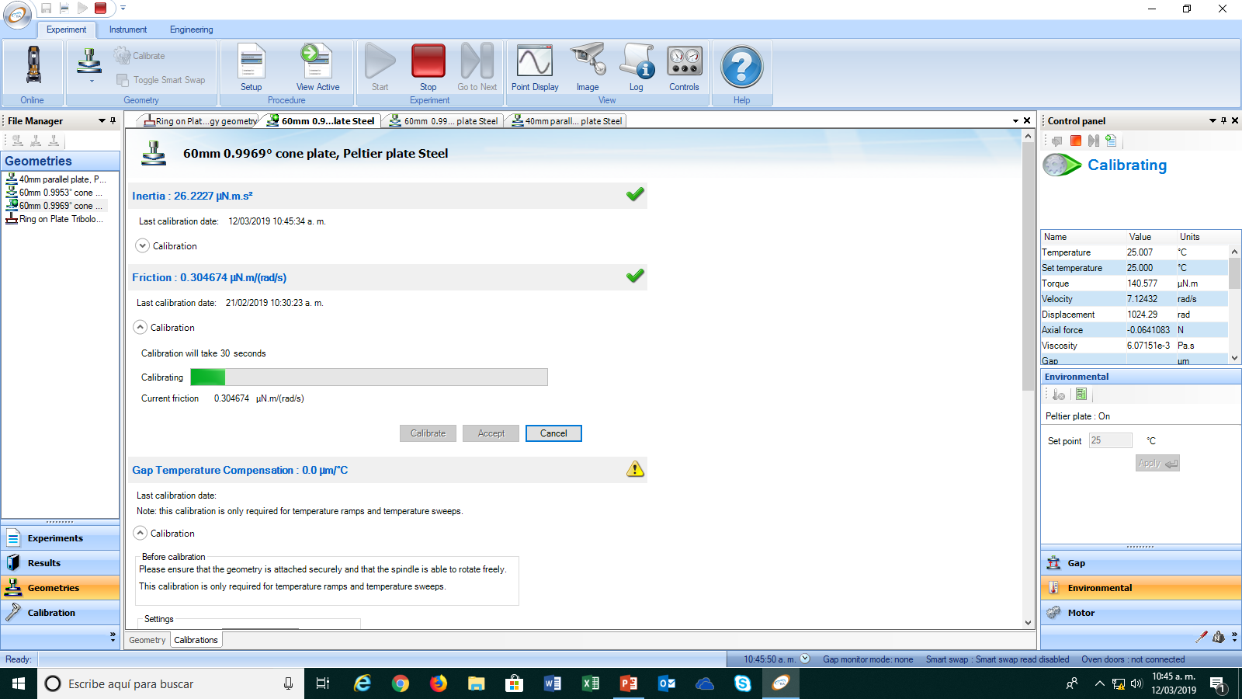
Procedure
Run the experiment
Open the TA software & connect to the instrument
input the experiment data
select the geometry
calibrate the instrument’s friction
calibrate the instrument’s inertia

Slide 11

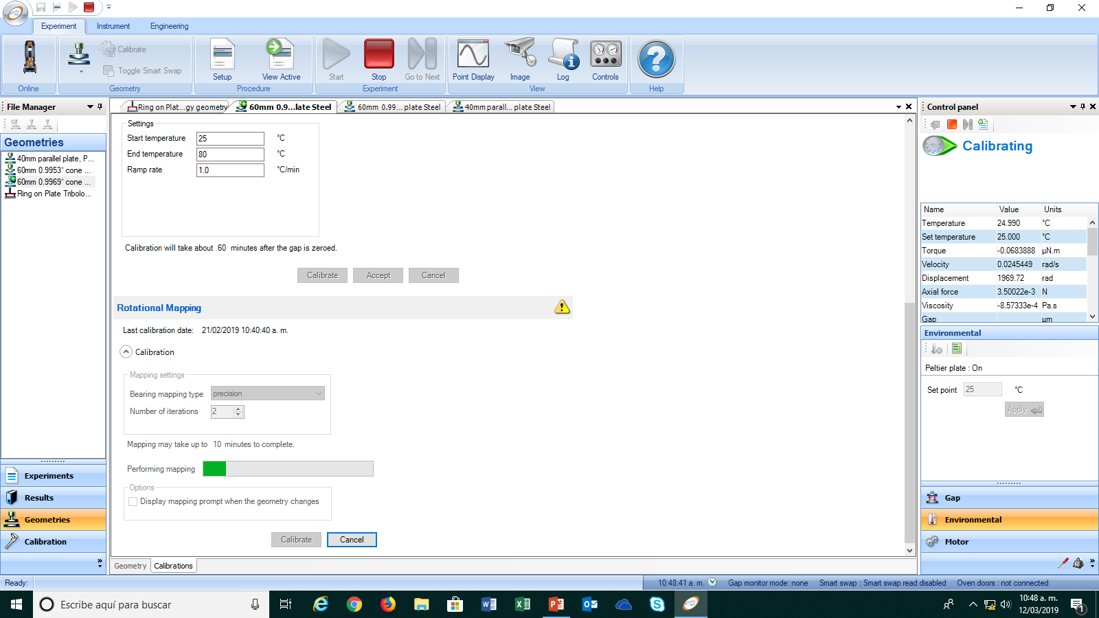
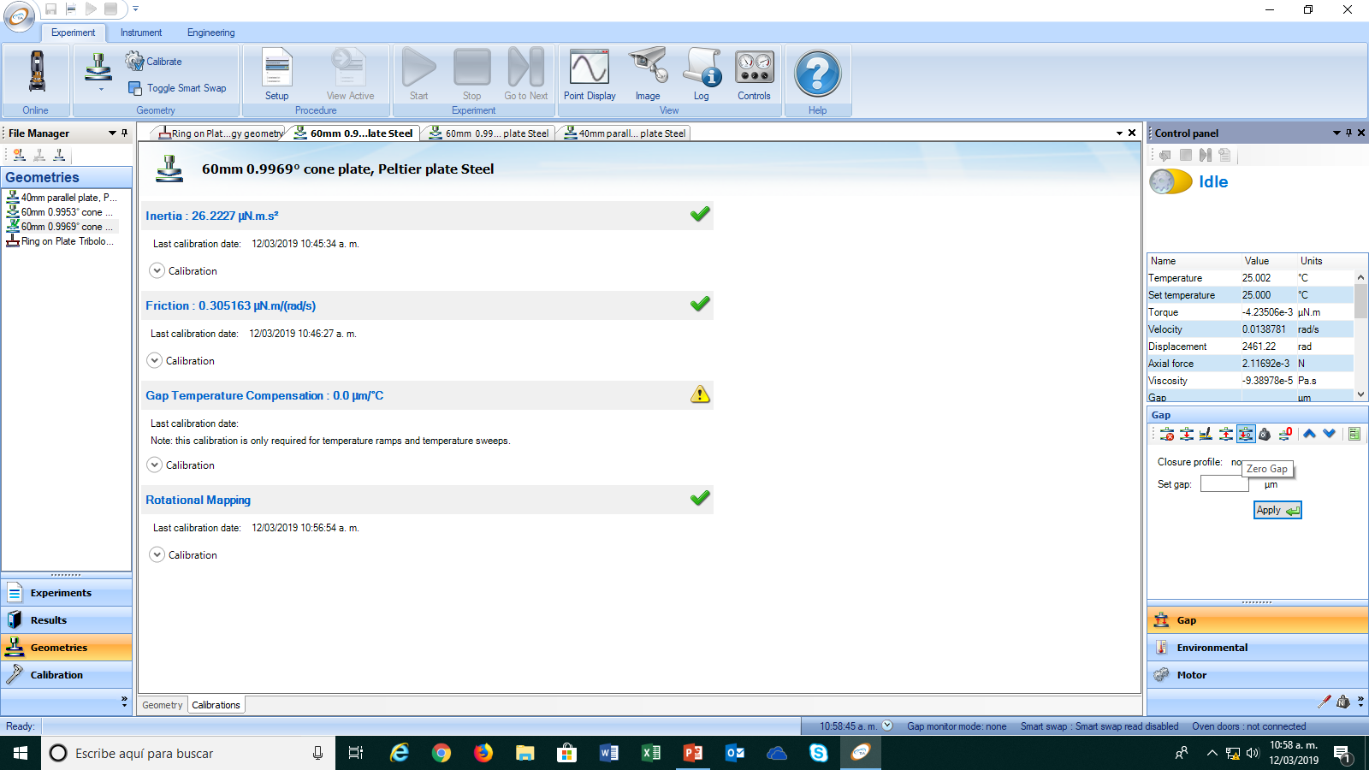
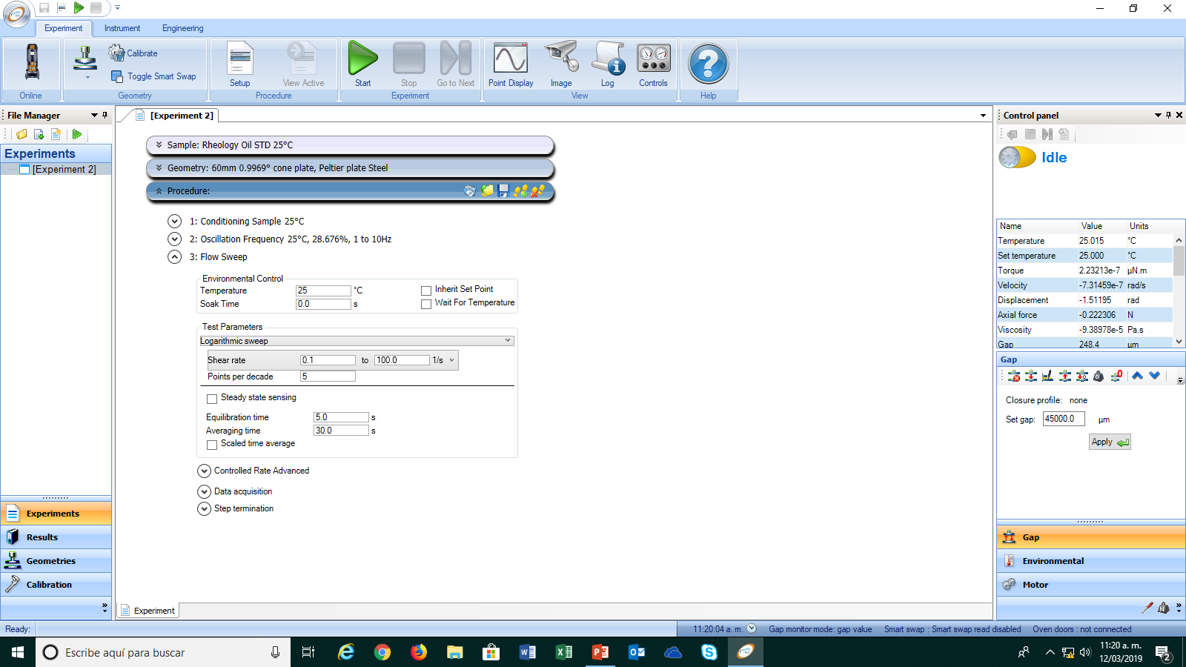
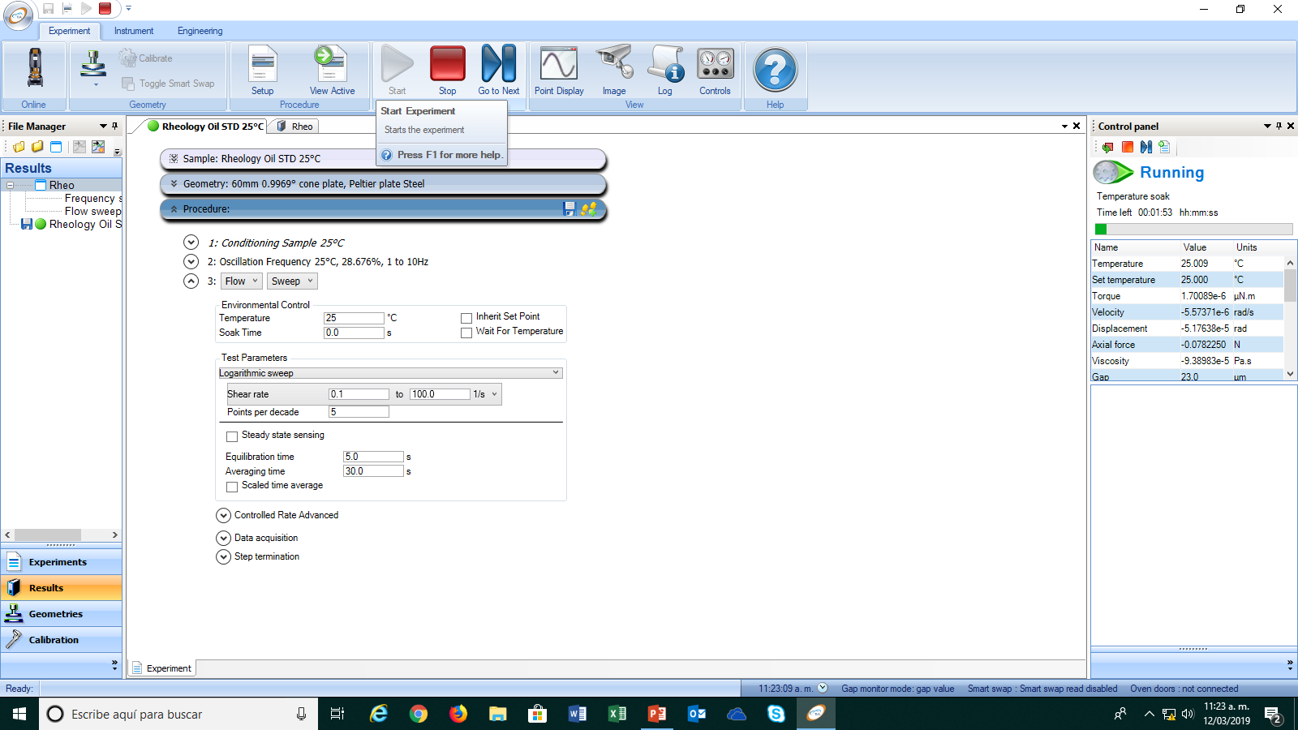
Procedure
Run the experiment (continued)
Set the plate’s temperature
perform the rotational mapping
1st
2nd
Get the Zero Gap
run the experiment
define the experimental procedure

Slide 12
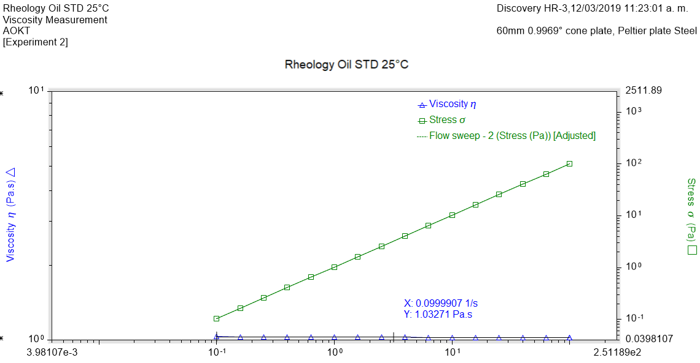
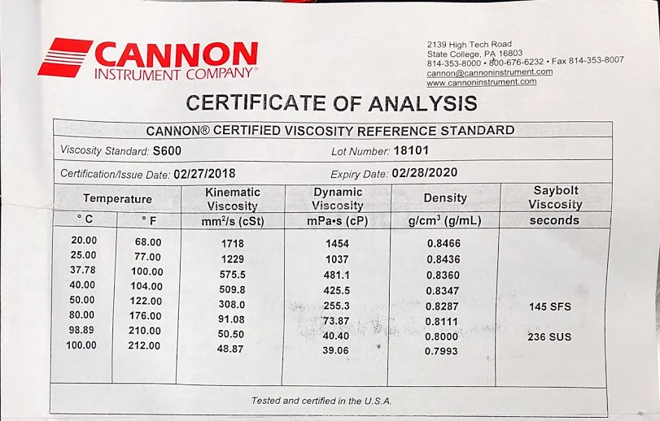
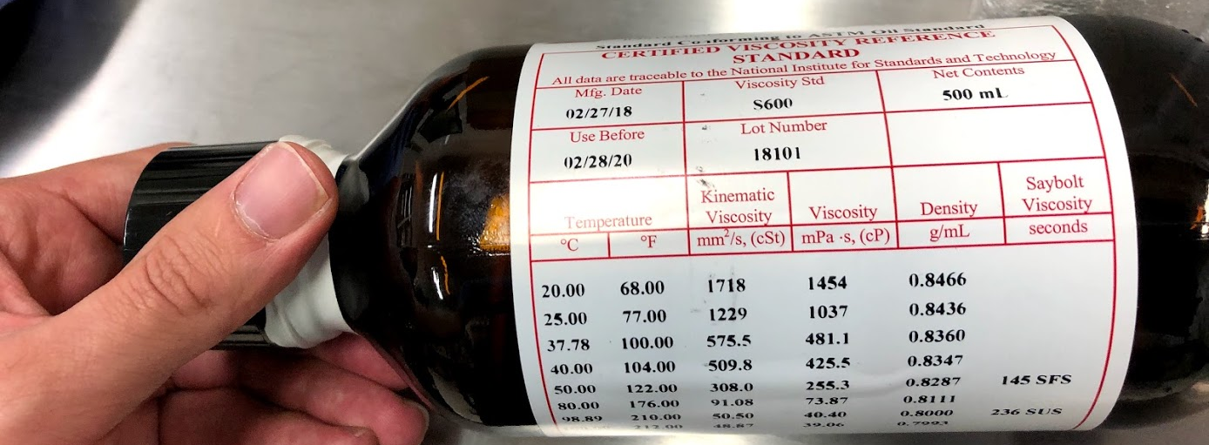
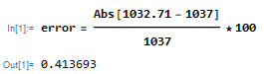
Results

